Slide 1

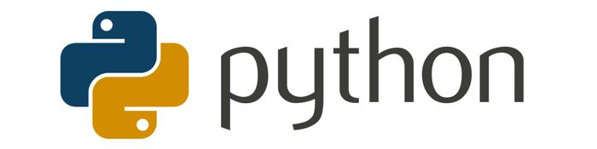
Loops, Functions
Python Workshop
By: Wameedh Scientific Club

Slide 2
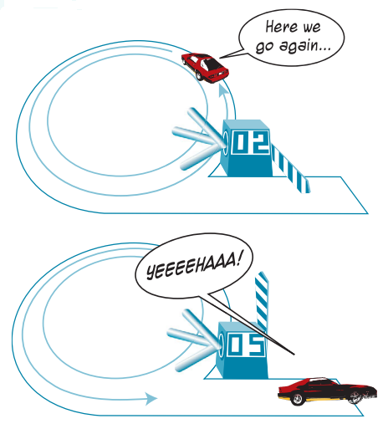
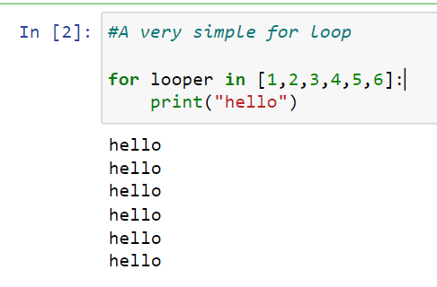
1. Counting Loop

Slide 3
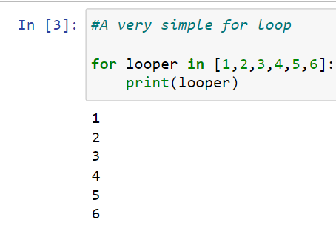
Using the Counting Loop Variable
We use Lists
in for loops!

Slide 4
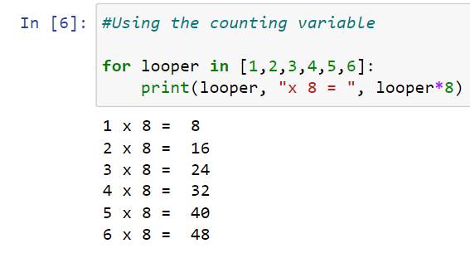
Using the Counting Loop Var.

Slide 5
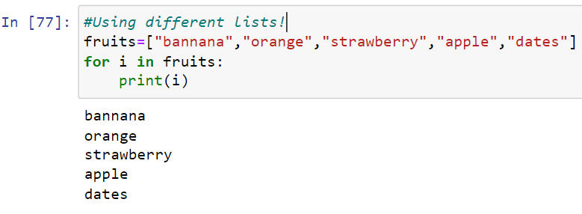
Counting without Numbers
A list can contain anything,
not just numbers

Slide 6
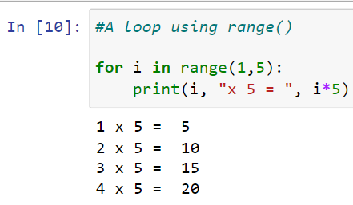
Counting Loop Using a Range
Less typing,
but it goes
from 1 to 4

Slide 7
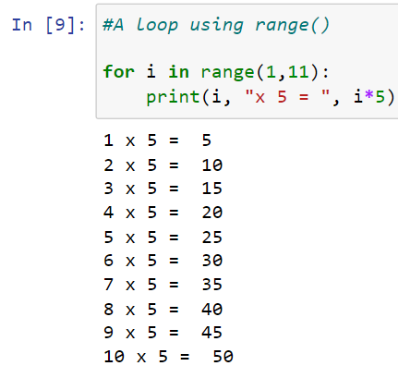
Eight Times Table
EightTimes.py
This range
goes from
1 to 10

Slide 8
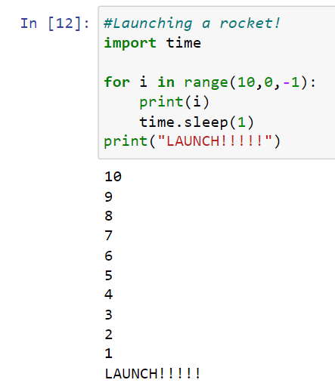
Range with a Step Amount
BlastOff.py
This range
goes from
10 to 1 in a
step of -1
This program
took 10 secs
to run.

Slide 9
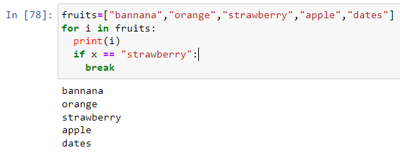
Using break in a Loop
break
makes
Python
leave the
loop

Slide 10
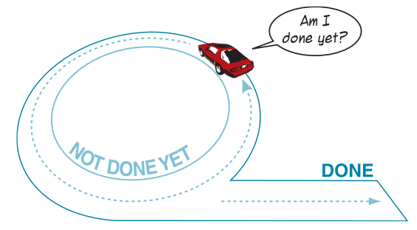
3. Conditional Loops
A conditional loop uses a test to decide when to stop looping
the same kind of test as in "if"

Slide 11
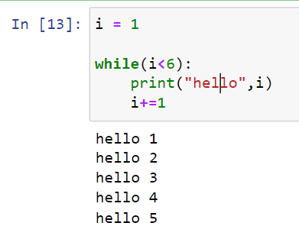
i < 6
is the test
the while body
is run over
and over
most while body's
need to include
an increment

Slide 12
Flowchart for Conditional Loop
program execution
i = 1
no; so finish
i < 6?
yes; keep going
loop back.
action
i = i + 1
execution
continues...

Slide 13
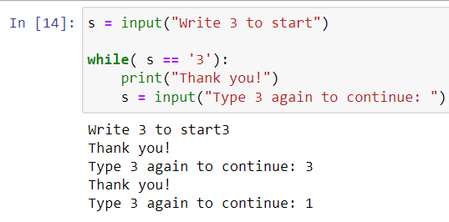
While that Likes "3"
While3.py

Slide 14
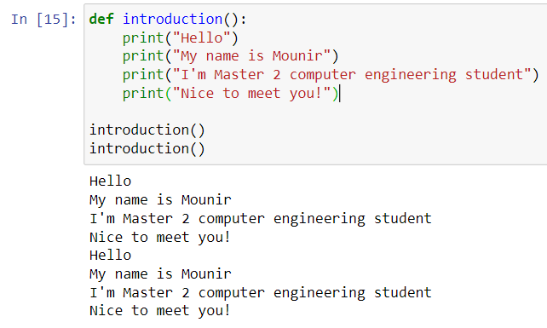
1. Intro Function
I often need to print an introduction
instead of writing the code many times, write the code once in a function, and reuse the function

Slide 15
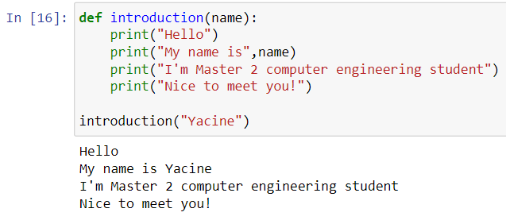
Making the Function More Reusable
Pass in data (an argument) to the function, which can change with each call.

Slide 16
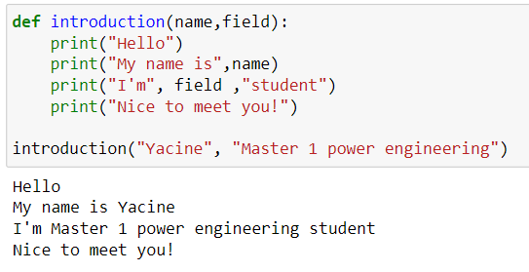
Many Arguments → Even More Reuseable
Address2.py

Slide 17
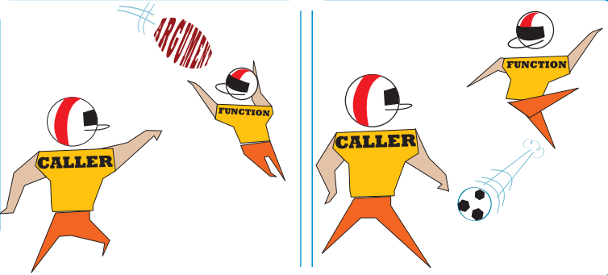
2. Having a Function Return Something
A function that calculates something would be very useful if it returned the answer back to the main program (the caller)
use return at the end of the function
return answer

Slide 18
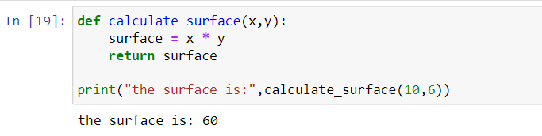
Calculating rectangle surface

Slide 19
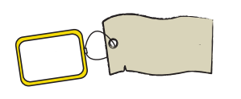
Main and Function in Pictures
main program
(the caller)
calculateTax()
(the function)
integer
copy data
x
1
y
:
surface =
calculate(
10, 6)
surface
:
return x*y
2
integer
copy data
surface

Slide 20


